Slide 1




Retail Sales Analysis
Analysis of 4 major retail stores customer data
Created by Nicholas Chavez

Slide 2
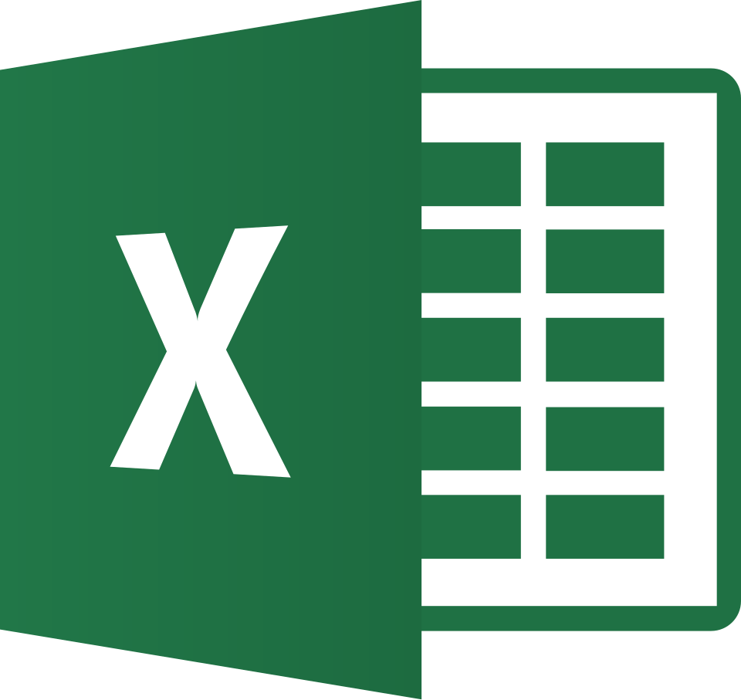

Tools and Tech
Excel
Power Query
Pivot Tables
Data Cleaning
Power BI
Data Visualization
Dashboard creation

Slide 3
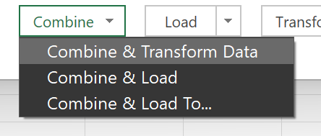



Method
Using Power Query I merged 3 of 4 datasets into One large Dataset

Slide 4
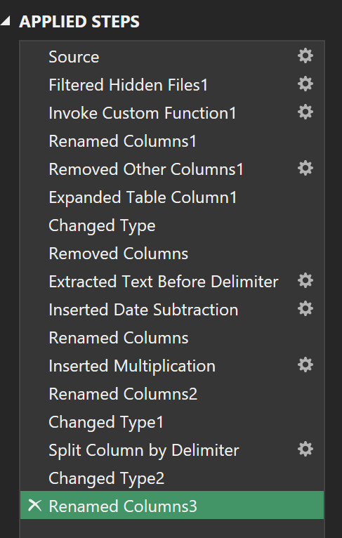


Method
In Power Query Editor I then cleaned the data:
Removed unneeded columns
Removed retailer names from the contact column
Calculated how long it takes to receive payment (renamed to days till payment)
Calculated a revenue column (renamed to revenue)
Changed monetary columns to the currency format
Separated region and state to separate columns
Renamed region to region and state to state
Close and loaded the data into an Excel Spreadsheet

Slide 5
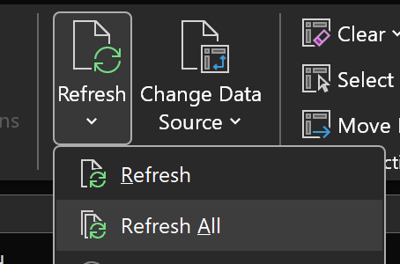
Method
Add one last data set after cleaning, no problem with Power Query

Slide 6

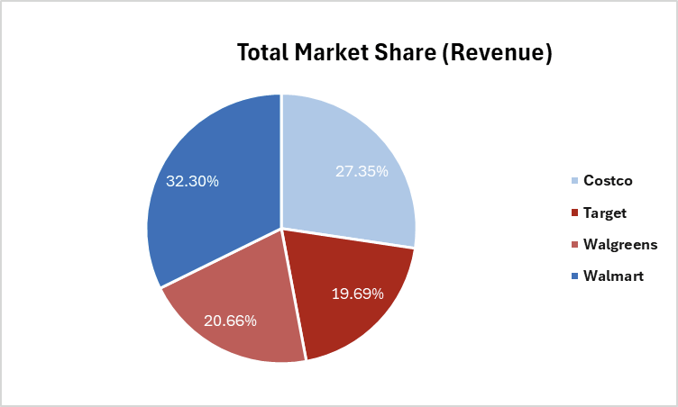
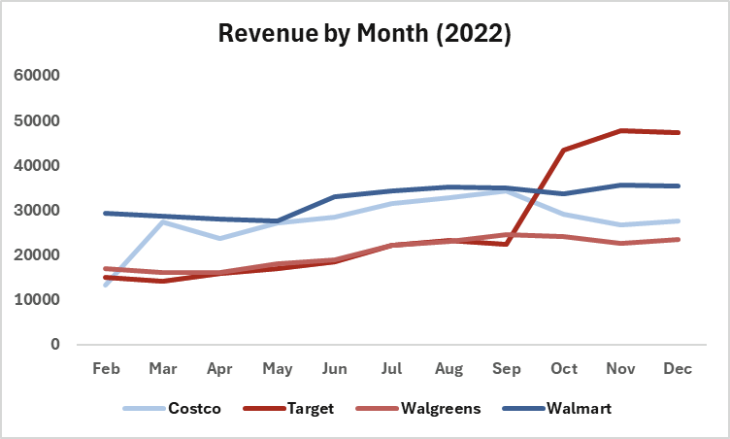
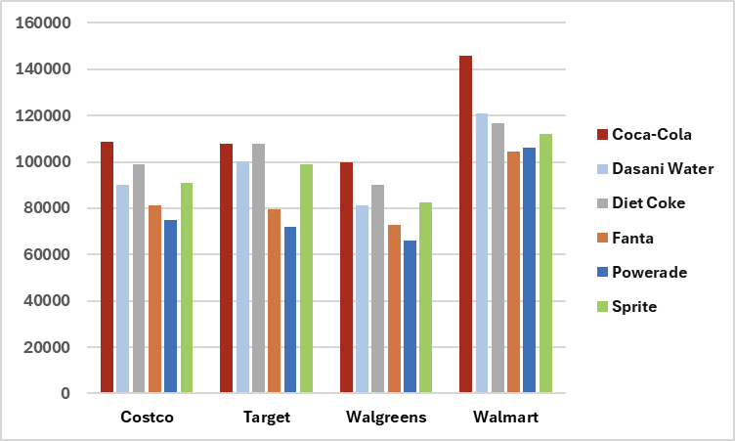
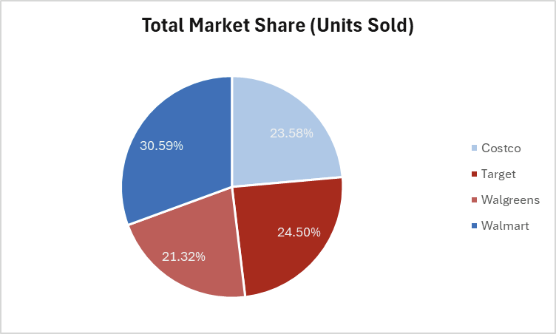
Method
In Excel I conduct Exploratory Data Analysis using Pivot tables and graphs:
Market share of revenue (Pie Chart)
Market share of unit’s sold (Pie Chart)
Count of each beverage brand by store (Bar Graph)
Revenue over the year 2022 (Line Chart)

Slide 7
Method
With the new file I then load Power BI to fully Visualize what was found

Slide 8
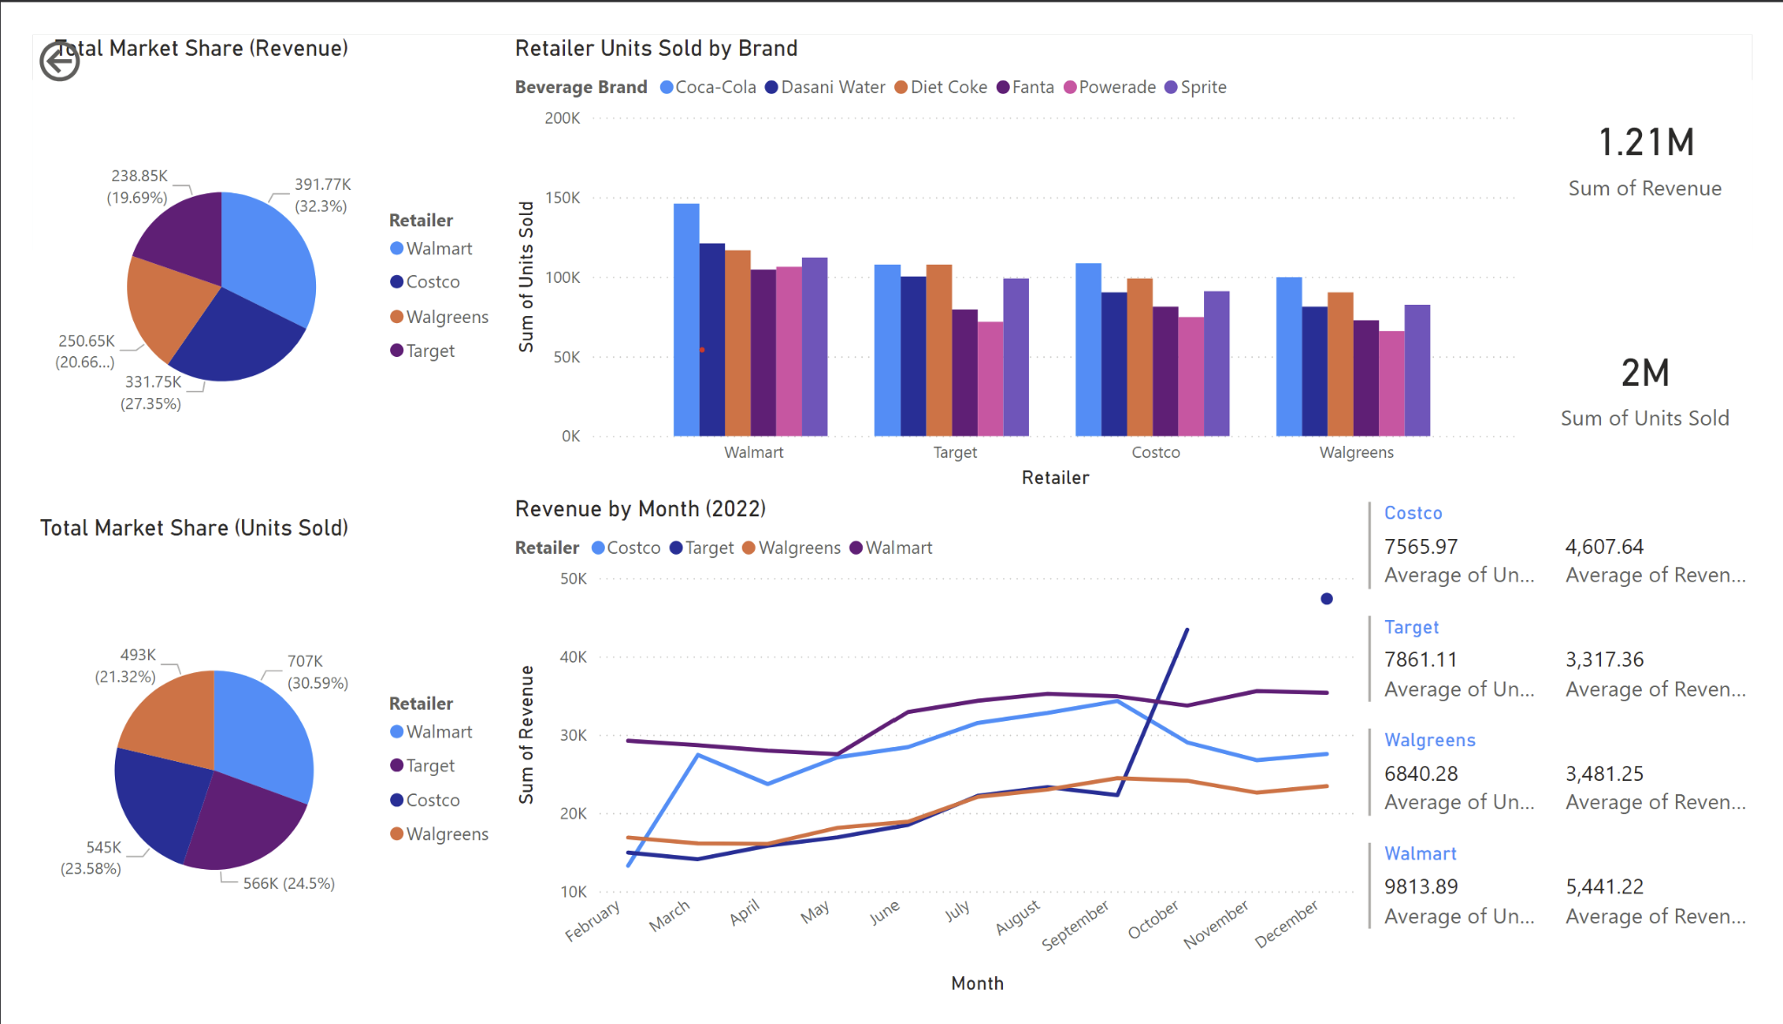
Dashboard
In PowerBI I then created an interactive dashboard using the cleaned data which showed many statistics:
Graphs and Charts from Excel
New score cards of Averages and Sums separated by retailer

Slide 9
Findings
Caveats
Through this analysis I was able to discover multiple insights:
Walmart outperformed all other retailers in revenue and units sold
Coca-Cola was the most sold beverage across all stores
Target had a spike of sales in October
There exist key issues with this data that must be mentioned:
The data comes from 4 individual stores that are in 4 different states (Variance in market condition state to state should be acknowledged)
Target lack observations for November, therefore average revenue was substituted
Data was limited to one year, (data include incomplete 2023 data, and said data was removed for the line chart)

